Slide 1
Lesson 1:
Deciding what to watch

Slide 2
Learning objectives and outcomes
BBFC Education
To learn how to make decisions and manage peer pressure about films and online viewing
You will be able to:
explain the factors that influence decisions about what film and online content is appropriate for young people
describe or demonstrate how to respond to pressure to watch something that makes someone feel uncomfortable
explain where and how to get help or advice about the film and online content
Lesson 1: Deciding what to watch

Slide 3
Overheard conversation
BBFC Education
Have you seen that new film? It’s called: Don’t look behind you!
Azi
Nah, not my thing. It’s rated 18, which must be for a reason. I’m not into blood and guts!
Riley
On your own, complete the ‘overheard conversation’ activity with your ideas for each question, using one colour.
Lesson 1: Deciding what to watch

Slide 4
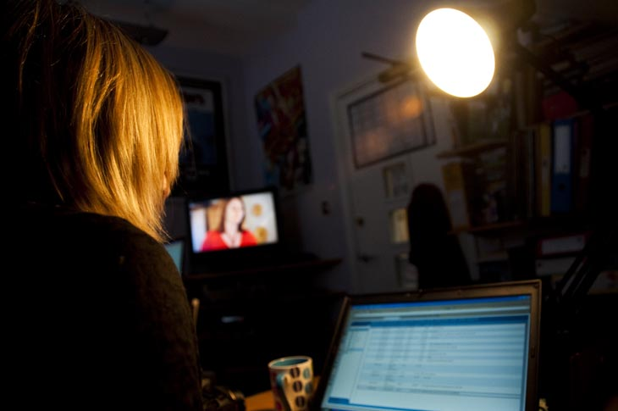
BBFC Education
The role of the BBFC
Some films and videos have things in them that can make viewers feel worried, confused or uncomfortable. The British Board of Film Classification (BBFC) wants audiences to enjoy watching films or online content, so their job is to view and classify films before general release.
The BBFC was set up in 1912 and has been providing age ratings for films for over 100 years. Part of the role of the BBFC is to listen to what the general viewing public think, and look at how they decide what to watch. Research projects with young people, teachers and parents are carried out across the country and the information gathered is used to make sure the advice is accurate and reflects societal attitudes.
Lesson 1: Deciding what to watch
Notes:
The photo is of BBFC Compliance Officer at work, age rating some visual material
Give a short introduction to the history and role of the BBFC, including how the BBFC chooses age ratings for films and ensures these are reliable.
Explain that the BBFC age rates films for release on DVD and at the cinema (U, PG, 12A/12, 15 or 18). Anyone wanting to release a film, video or DVD for showing in cinemas or watching at home has to make sure that their film has a BBFC age rating symbol. It is against the law to try and sell videos and DVDs without a rating. Films viewed at the cinema also have to display the correct rating.

Slide 5
BBFC Education
The BBFC age ratings
The BBFC uses age rating symbols and provides explanations about films, videos, and some films and series viewed online.
This helps viewers decide what to watch, or what might not be suitable.
Lesson 1: Deciding what to watch
Notes:
Discuss with the pupils why the ratings are important and why the BBFC thinks some content is not suitable for younger viewers.

Slide 6
Film classification
BBFC Education
1 2 3 4 5 6 7 8 9 10 11 12 13 14 15 16 17 18
Toddler
Adult
Think about how the classification cards fit along your timeline from toddler to adult.
Which description do you think is appropriate to watch at different ages along the timeline?
Lesson 1: Deciding what to watch

Slide 7
Film classification
BBFC Education
Discriminatory language or behaviour is unacceptable unless clearly disapproved of (e.g. by characters in the film).
Violence will generally be very mild. Mild violence may be acceptable if it is justified by context (for example, comedic, animated, wholly unrealistic).
Scary or potentially unsettling scenes should be mild, brief and unlikely to cause undue anxiety to young children. The outcome should be reassuring.
References to illegal drugs or drug misuse must be innocuous or carry a suitable anti-drug message.
Discriminatory language or behaviour is unacceptable unless clearly disapproved of (e.g. by characters in the film), or if it is in an educational or historical context, or in a particularly dated work with no likely appeal to children.
Mild bad language only. Aggressive or very frequent use of mild bad language may result in a film being passed at a higher category.
Lesson 1: Deciding what to watch
Notes:
Answers to timeline task

Slide 8
Film classification
BBFC Education
No promotion of potentially dangerous behaviour which children are likely to copy. No glamorisation of realistic or easily accessible weapons such as knives.
There may be moderate physical and psychological threat and horror scenes. Although some scenes may be disturbing, the overall tone should not be.
Misuse of drugs must be infrequent and should not be glamorised or give detailed instruction.
The film as a whole must not endorse discriminatory language or behaviour, although there may be racist, homophobic or other discriminatory themes and language.
Violence may be strong but should not dwell on the infliction of pain or injury. The strongest gory images are unlikely to be acceptable.
Drug taking may be shown but the film as a whole must not promote or encourage drug misuse (for example, through detailed instruction).
Lesson 1: Deciding what to watch
Notes:
Answers to timeline task

Slide 9
The conversation continues
BBFC Education
Azi
Yeah, but I got a copy from my sister’s mate, we can watch it later.
I’m not sure, it’s a horror, isn’t it?
Riley
What thoughts and feelings might be making Azi pressure Riley into watching the film?
What might Riley be thinking and feeling?
Azi
It’s not that scary apparently. We’ve got to watch it tonight, it’s pizza and film night!
Ummmm…
Riley
Azi
Go on, you know you want to…
But it’s still an 18, isn’t it?
Riley
Azi
Nah, think it’s a 15. It doesn’t matter though, loads of people have seen it. No one thinks it was actually scary.

Slide 10
To watch or not to watch?
BBFC Education
Reasons for Riley to watch the film
Reasons for Riley not to watch the film
Lesson 1: Deciding what to watch
Notes:
https://pixabay.com/illustrations/post-it-note-memo-paper-1495148/

Slide 11
Responses to pressure to watch the film
BBFC Education
What could Riley tell themselves?
What could Riley say to their friends?
What could Riley do?
Lesson 1: Deciding what to watch

Slide 12
Back to the ‘overheard conversation’
BBFC Education
Using a different colour pen to the beginning of the lesson, revisit your ‘overheard conversation’ activity.
Can you add any more information?
Does anything need correcting or changing?
Lesson 1: Deciding what to watch

Slide 13
Sources of support
BBFC Education
If you are concerned about watching a film or a film you have watched you can talk to:
Parents/carers
Tutor
PSHE Teacher
Head of Year/House
Further information about films, including new releases and age ratings can be found on CBBFC website: www.cbbfc.co.uk or www.bbfc.co.uk/education
Lesson 1: Deciding what to watch
Notes:
Image: https://pixabay.com/illustrations/help-information-problem-solution-1013700/

Slide 14
Extension Activity
BBFC Education
Create a top tips pocket guide to managing peer influence.
Include at least five key messages for young people focused around film and online content choices.
Lesson 1: Deciding what to watch
Notes:
Image: https://pixabay.com/illustrations/list-icon-symbol-paper-sign-flat-2389219/

